Slide 1

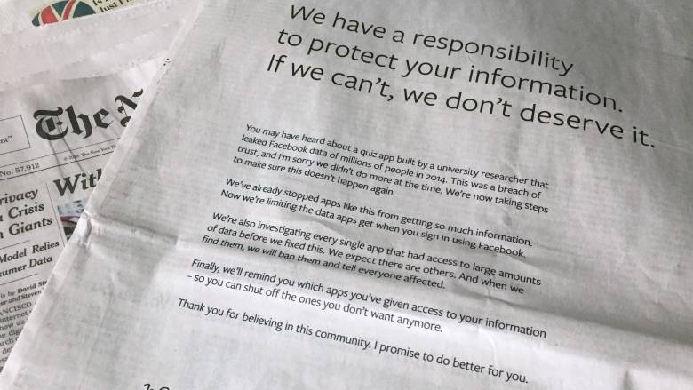

Reputation First
15688 Team Project
Shengjie Luo
Yupeng Zhang
Ke Chang
Notes:
Hello everyone, our project called “Reputation First”, the public opinion research based on public media.

Slide 2
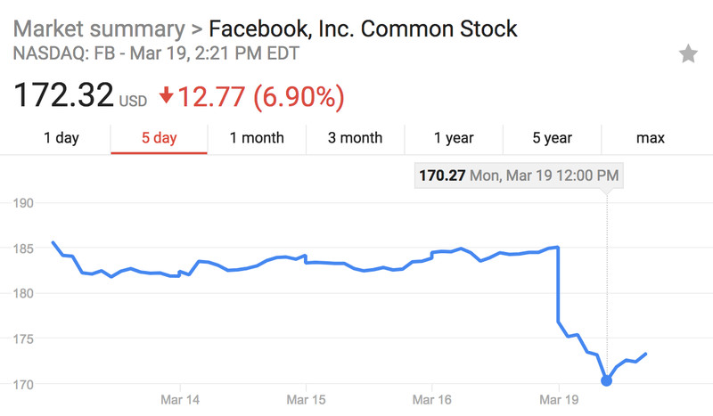
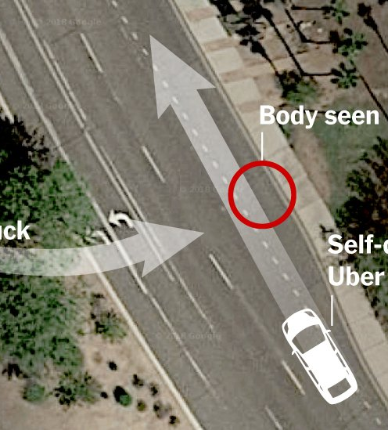
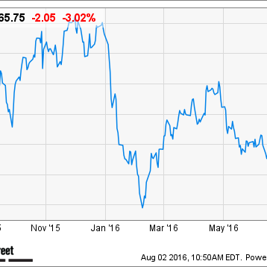

Facebook and Uber Loses Billions of Money Following Reputation Crisis. Reputation First for Company.
Notes:
Facebook is experiencing the largest serious reputation crisis both in public media and internet space, leading to losing billions of dollars. Today, the public reputations matters a lot for each company, which motivates us to dive into the data world and find the relation between public reputation and media information.

Slide 3
Notes:
Beginning from the public media articles, we employee the power of distributed internet crawler to fetch data. After which we use Spark and Yarn to clean data and apply textrank algorithm to extract the summary from original text. In the next step, python NLTK is a good solution to handle the sentiment analysis and extract the media attitude from articles. Finally, these messages are combined to predict the reputation score.

Slide 4
Notes:
Beginning from the public media articles, we employee the power of distributed internet crawler to fetch data. After which we use Spark and Yarn to clean data and apply textrank algorithm to extract the summary from original text. In the next step, python NLTK is a good solution to handle the sentiment analysis and extract the media attitude from articles. Finally, these messages are combined to predict the reputation score.

Slide 5
Notes:
Beginning from the public media articles, we employee the power of distributed internet crawler to fetch data. After which we use Spark and Yarn to clean data and apply textrank algorithm to extract the summary from original text. In the next step, python NLTK is a good solution to handle the sentiment analysis and extract the media attitude from articles. Finally, these messages are combined to predict the reputation score.

Slide 6
Notes:
Beginning from the public media articles, we employee the power of distributed internet crawler to fetch data. After which we use Spark and Yarn to clean data and apply textrank algorithm to extract the summary from original text. In the next step, python NLTK is a good solution to handle the sentiment analysis and extract the media attitude from articles. Finally, these messages are combined to predict the reputation score.

Slide 7
Notes:
Beginning from the public media articles, we employee the power of distributed internet crawler to fetch data. After which we use Spark and Yarn to clean data and apply textrank algorithm to extract the summary from original text. In the next step, python NLTK is a good solution to handle the sentiment analysis and extract the media attitude from articles. Finally, these messages are combined to predict the reputation score.

Slide 8
Notes:
Beginning from the public media articles, we employee the power of distributed internet crawler to fetch data. After which we use Spark and Yarn to clean data and apply textrank algorithm to extract the summary from original text. In the next step, python NLTK is a good solution to handle the sentiment analysis and extract the media attitude from articles. Finally, these messages are combined to predict the reputation score.

Slide 9
Notes:
Beginning from the public media articles, we employee the power of distributed internet crawler to fetch data. After which we use Spark and Yarn to clean data and apply textrank algorithm to extract the summary from original text. In the next step, python NLTK is a good solution to handle the sentiment analysis and extract the media attitude from articles. Finally, these messages are combined to predict the reputation score.

Slide 10
600 Million
Notes:
One of the largest challenge of our project is how to process 2GB data and 600Million tokens efficiently in 3 different stages.
Faced with the bigdata challenge, we use a spark cluster within 8cores to accelerate the workload from 73.9 hours to 9.8 hours.

Slide 11
600 Million
Tokens
2 GB
Data
Notes:
One of the largest challenge of our project is how to process 2GB data and 600Million tokens efficiently in 3 different stages.
Faced with the bigdata challenge, we use a spark cluster within 8cores to accelerate the workload from 73.9 hours to 9.8 hours.

Slide 12
600 Million
Tokens
2 GB
Data
3 Stage
Each Item
Notes:
One of the largest challenge of our project is how to process 2GB data and 600Million tokens efficiently in 3 different stages.
Faced with the bigdata challenge, we use a spark cluster within 8cores to accelerate the workload from 73.9 hours to 9.8 hours.

Slide 13
600 Million
Tokens
2 GB
Data
3 Stage
Each Item
Traditional Method
73.9 Hours
Notes:
One of the largest challenge of our project is how to process 2GB data and 600Million tokens efficiently in 3 different stages.
Faced with the bigdata challenge, we use a spark cluster within 8cores to accelerate the workload from 73.9 hours to 9.8 hours.

Slide 14
600 Million
Tokens
2 GB
Data
3 Stage
Each Item
Traditional Method
73.9 Hours
Spark Method
8 CPUS 120GB
9.8 Hours
Notes:
One of the largest challenge of our project is how to process 2GB data and 600Million tokens efficiently in 3 different stages.
Faced with the bigdata challenge, we use a spark cluster within 8cores to accelerate the workload from 73.9 hours to 9.8 hours.

Slide 15
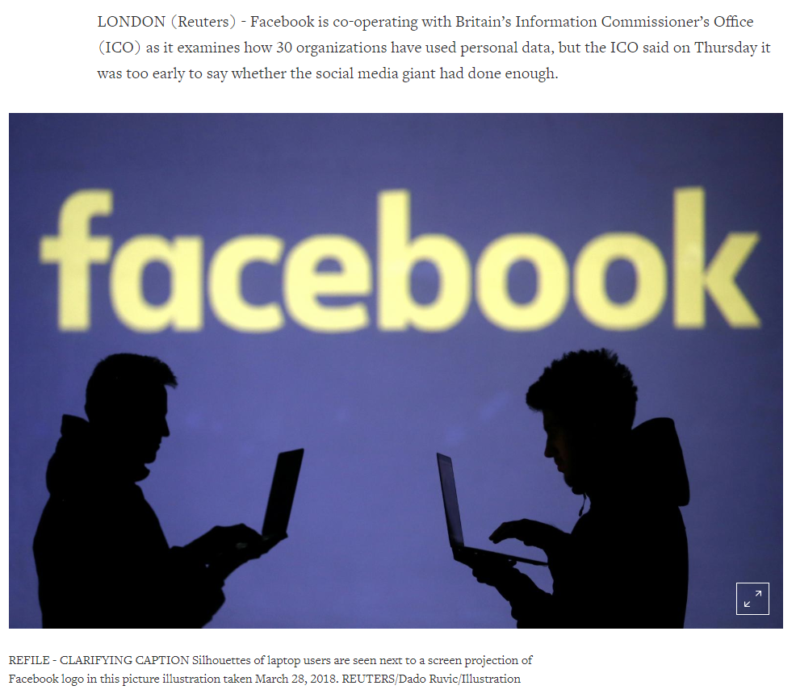
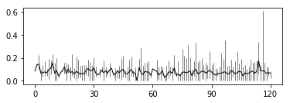
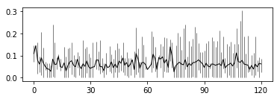
Case Analysis
Negative News Trend in recent 120 days
Positive News Trend in recent 120 days
Notes:
In this user case,

Slide 16
Reputation First
Thanks
Notes:
We are looking forward to extending this project into a realtime analysis tool in the future. Thank you for your participation!

